Slide 1
Team DeepInAI
AI Genesis Hackathon 2023
Theme : Social Media and Generative AI
By : Zoya Jamadar
B.Tech Artificial Intelligence and Data Science. 2024

Slide 2

Let me Introduce myself …
👋🏼 Hey there,
I’m Zoya Jamadar, and I'm currently pursuing my Final year B.Tech in Artificial Intelligence and Data Science.
I'm passionate about designing cutting-edge technologies that can make a positive impact on society. My projects are focused on sustainable solutions and goals, and I'm always looking for new opportunities to challenge myself and make a difference.
That's why I'm really excited about the AI Genesis Hackathon! It's a chance for me to explore the Generative AI world, and see how I can apply my skills to this exciting field.
I'm confident that I can contribute to the challenge and design innovative solutions that address real-world problems
Overall, I'm thrilled to be part of this Hackathon, and I can't wait to see what the future holds!

Slide 3

Problem Statement
The exponential increase in the generation of fake data, facilitated by the emergence of Generative Adversarial Neural Networks (GANs), has resulted in a rise in social scams..
The project aims to develop algorithms that can be integrated into social media platforms to effectively identify and classify Deep Fake images and social posts, thus curbing the proliferation of Fake news.
To this problem we target LinkedIn application with our neural network model

Slide 4
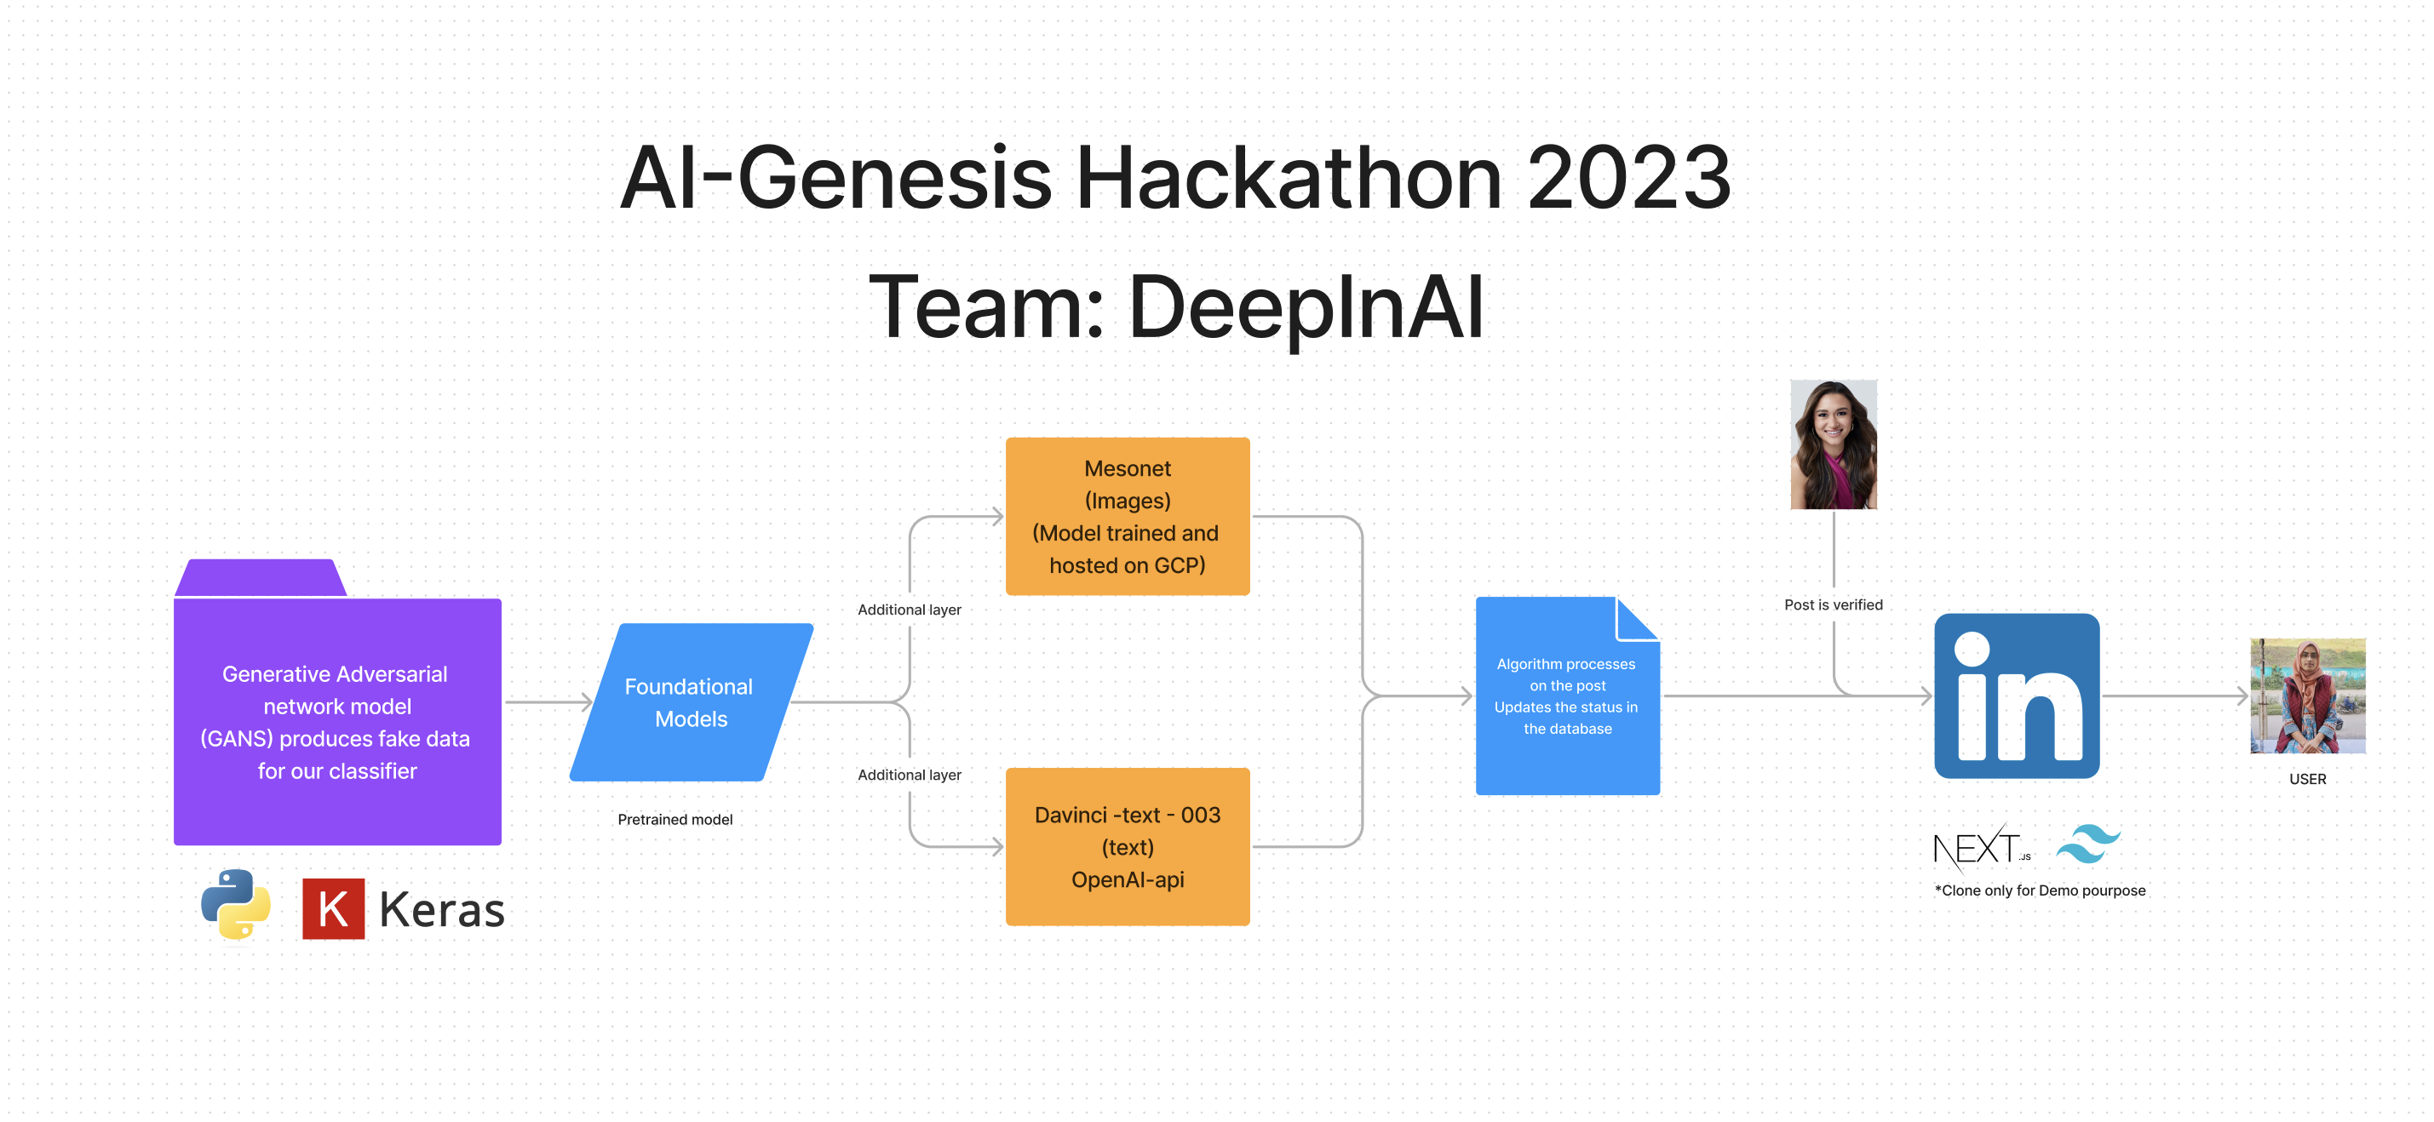
Proposed Architecture - Prototype

Slide 5
Explanation
Addressing the issue of social scam, This project aims to tackle this pressing issue, by demonstrating a LinkedIn application clone has been developed.
Leveraging data sourced from a comprehensive database, this application incorporates a dual-layered approach utilizing the Mesonet algorithm and OpenAI's advanced GPT-3 davinci-text-003 model for classification purposes.
By employing an AND gate on the output of these algorithms, the system generates conclusive results that accurately classify posts as either suspected scams or verified truths.
All this has been done using NextJS 13 and Tailwind for frontend. OpenAI, Tensor-flow and Pytorch for powering AI Algorithms

Slide 6
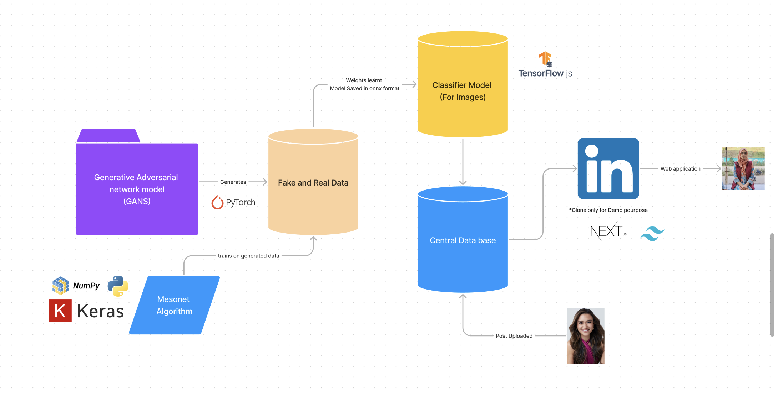
Proposed Architecture – Real Time Scaling

Slide 7
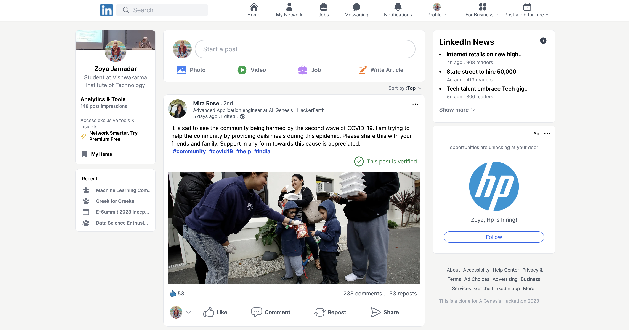
Application Preview

Slide 8
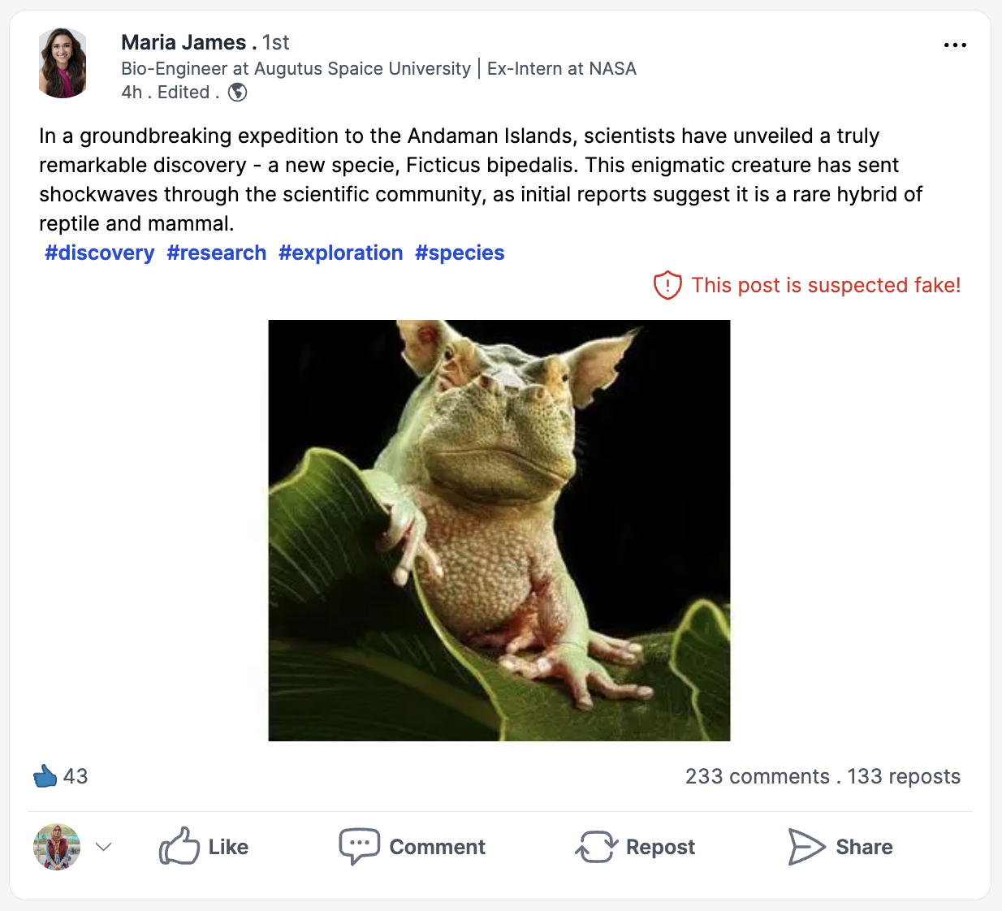
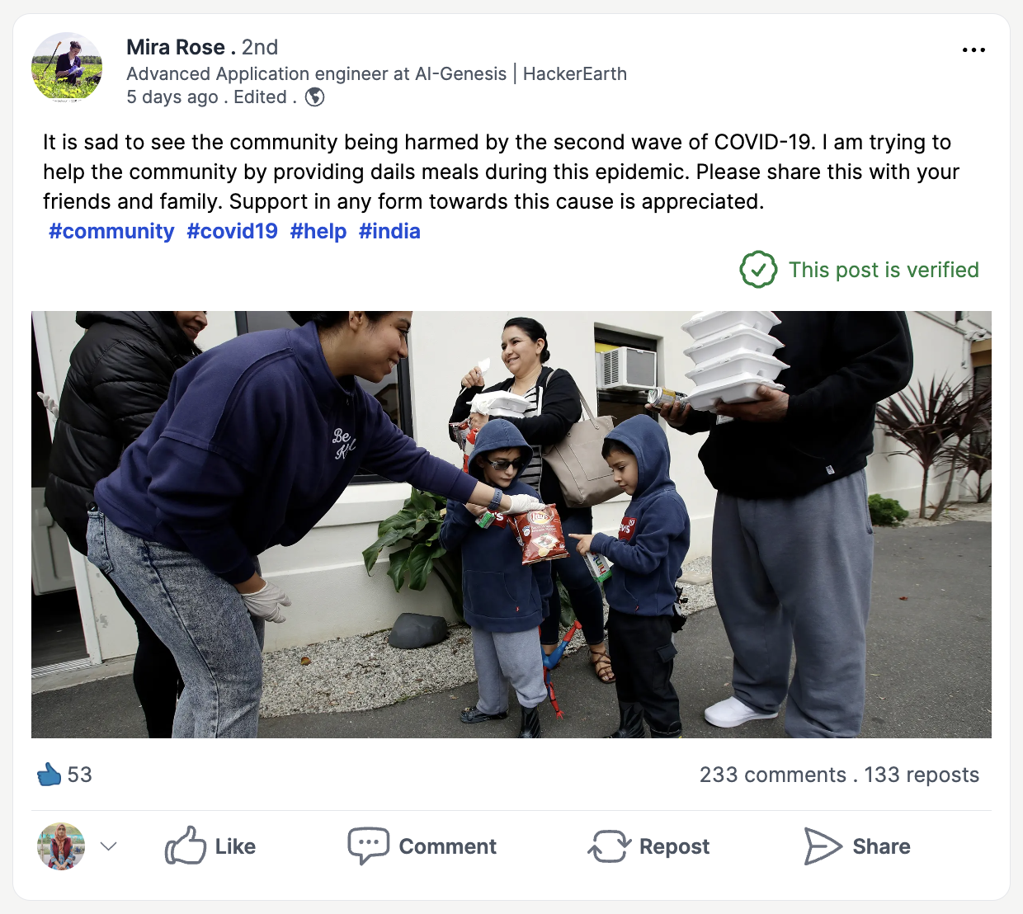
Application Preview

Slide 9
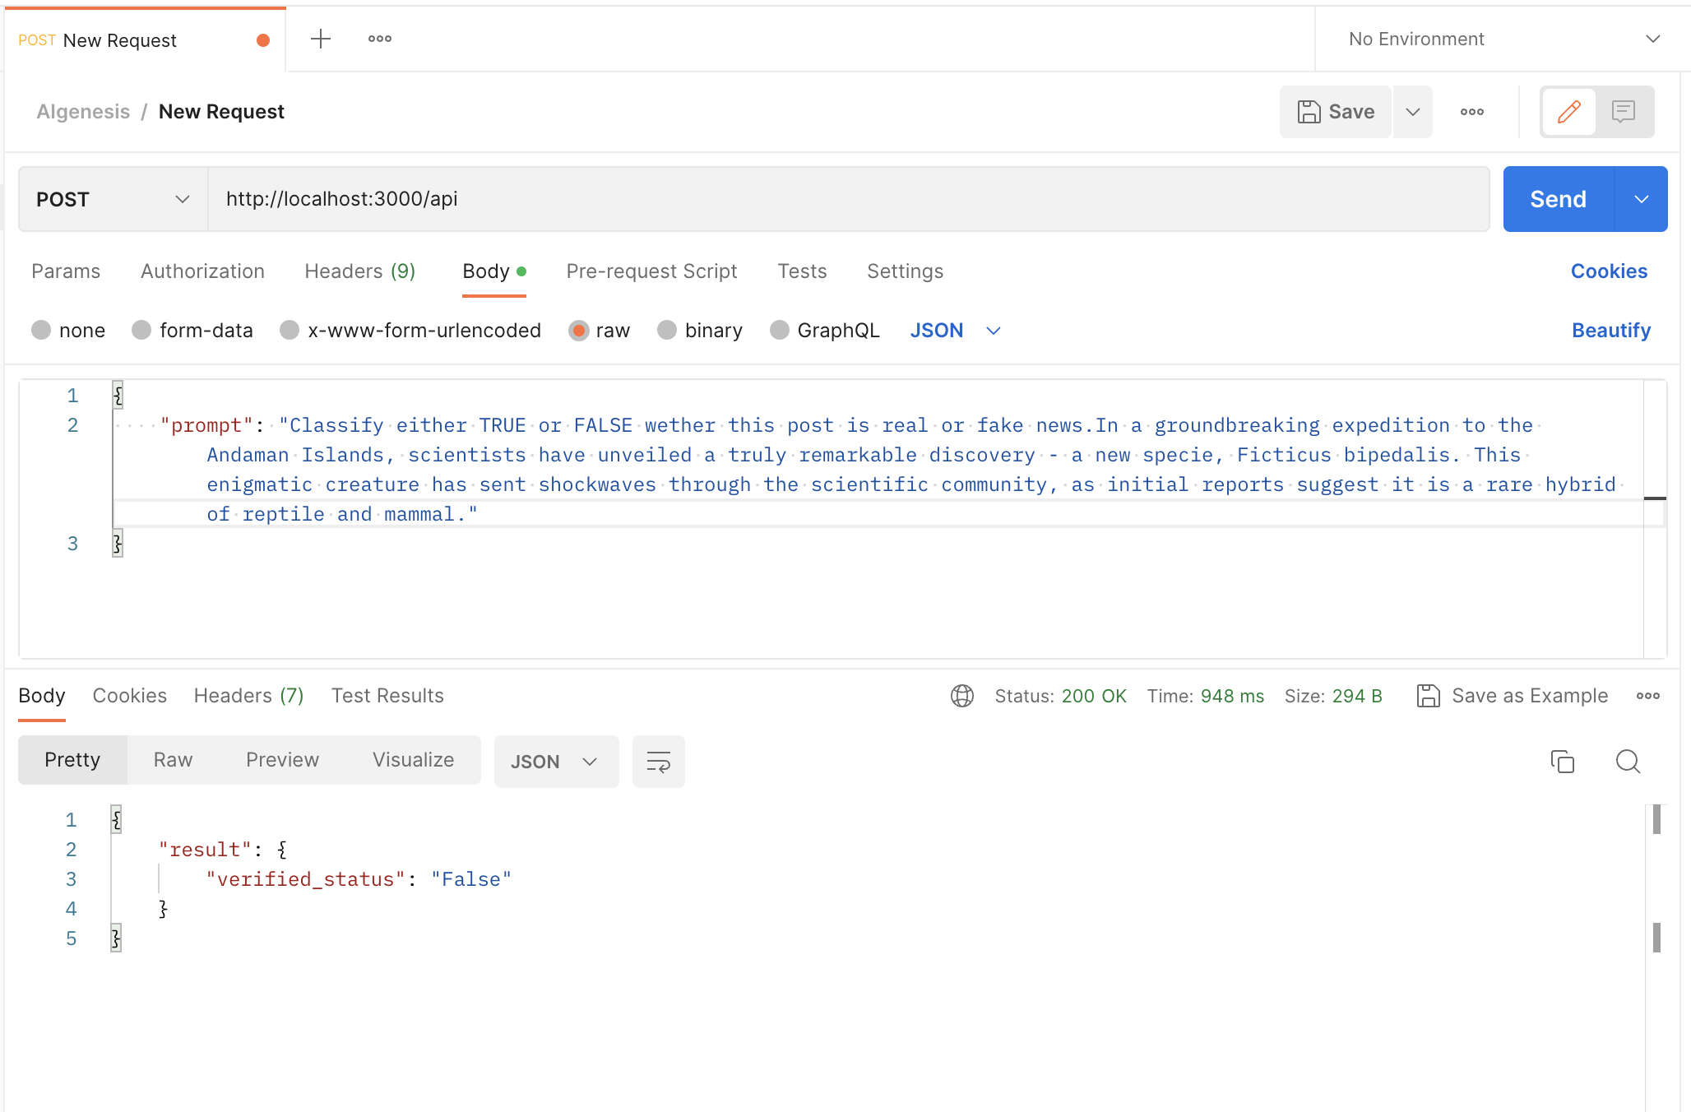
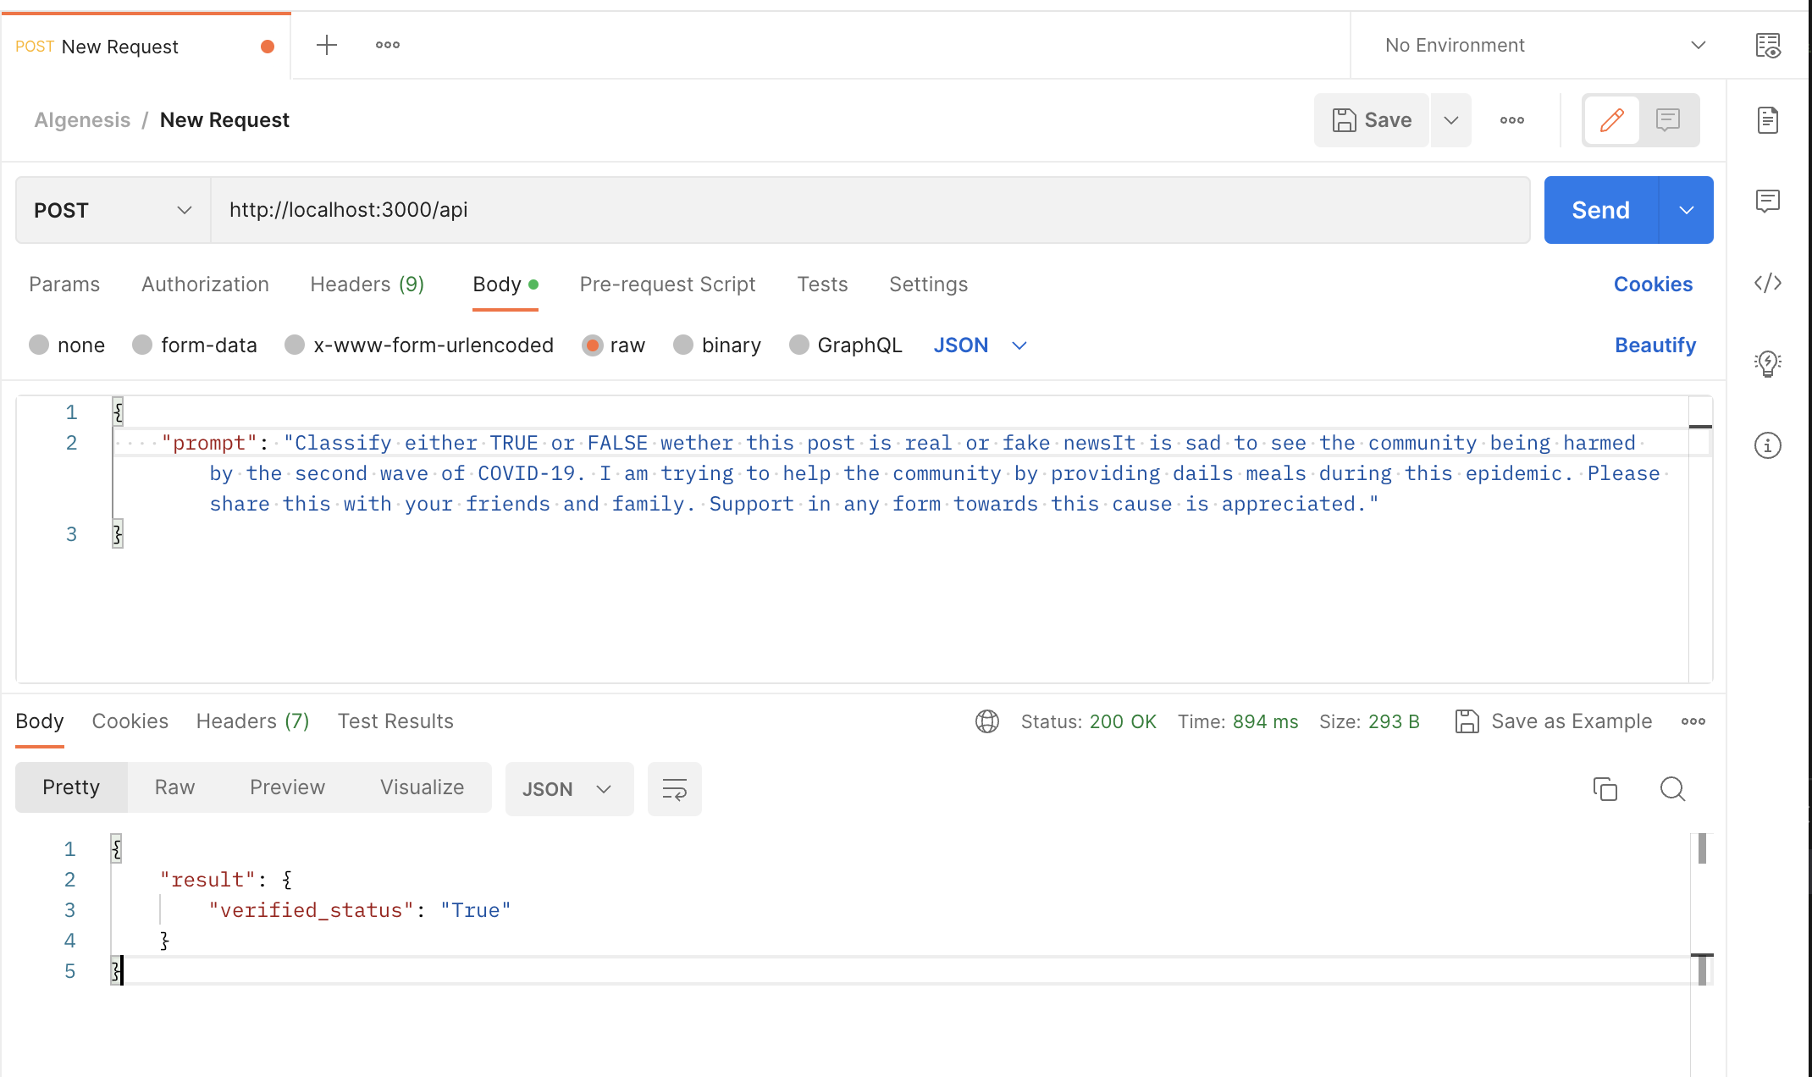
API Testing over Postman

Slide 10
American Express Makeathon 2023
Team DeepInAI
Thankyou ..
Please let us know your feedbacks they hold immense value to me

